Slide 1
Predicting Song Popularity
Applied Data Science Capstone

Slide 2
Why is this important?
As an artist, songwriter, or music producer, you want your music to be liked by the general audience
Can the metrics or features of the song determine the song’s popularity?
If so, what are the features that affect the song’s popularity? Is there a correlation between the features and popularity?
Can we predict if a song will be popular based on its features?

Slide 3
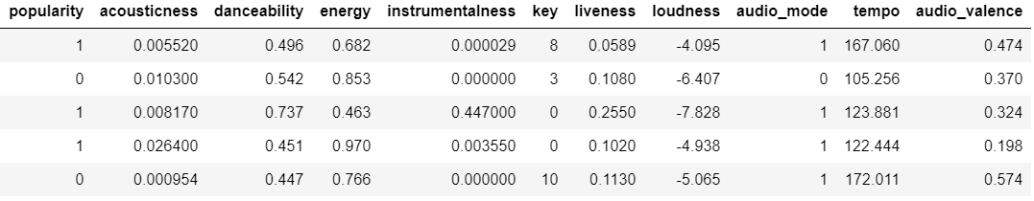
The Data
The dataset has been provided by Spotify and Kaggle
It includes 19000 songs with 15 features of which 10 will be used to determine the popularity:
Target variable: Popularity
Songs with a song_popularity value greater than 70 is set as popularity value 1, else 0
Dependent variables (features): Acousticness, Danceability, Energy, Instrumentalness, Key, Liveness, Loudness, Audio_mode, Tempo, and Audio_valence

Slide 4
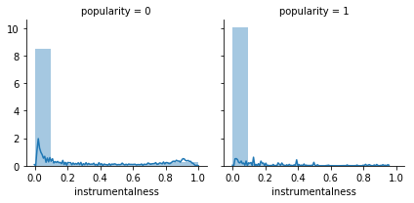
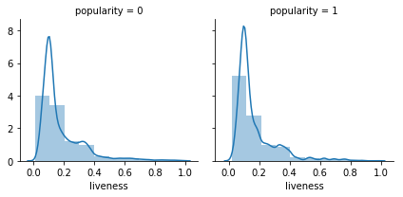
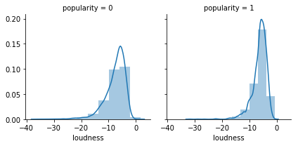
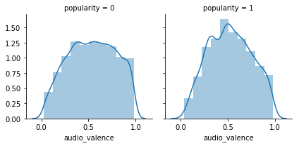
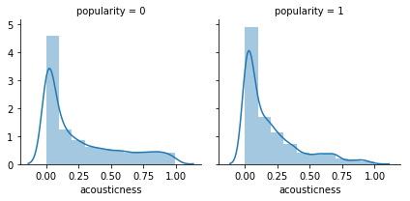
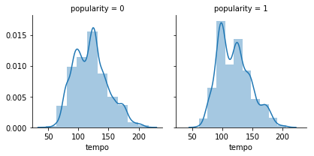
The Features
This is the distribution of each feature by popularity

Slide 5
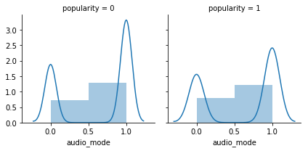
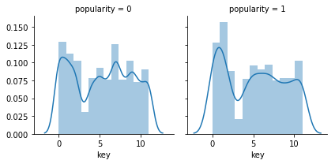
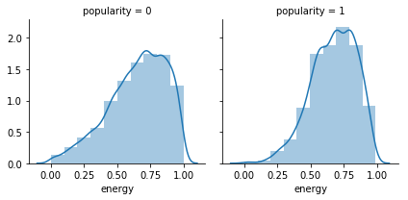
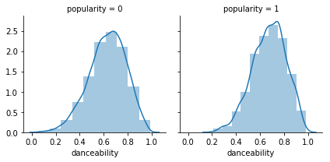
The Features
Each feature was found significantly different between popular and unpopular songs. They’re also significantly correlated to popularity.

Slide 6
Classification Model
Logistic Regression
K Nearest Neighbor
Decision Tree
Support Vector Machine
These models were chosen because of we found a significant difference in the features between popular and unpopular songs. And these models work best with classification problems.

Slide 7
Conclusion and Next Steps
K Nearest Neighbor most accurately predicted the popularity of the songs based on its features with ~84% accuracy
Next questions to ask:
How does other features add to the popularity like artist name, song name, genre, release year, etc.?
How has the trend in popular songs’ features changed in the past 10 years? 20 years? 50 years?
How accurately can we predict the popularity score?

